Slide 1
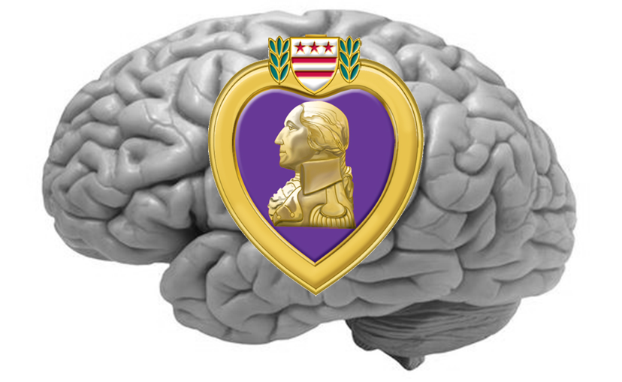

TBI/PTSD and the Suicide Epidemic:
Breaking the Cycle
TreatNOW.org
Heal brains. Stop Suicides. Restore lives.
The Stories that follow are illustrative of the work the
TreatNOW Coalition has been performing for sixteen years:
Veterans, Active duty, National Guard, Reserves, First Responders, citizens
and athletes returned to healthier lives after being told there
was little to nothing conventional medicine could do
to heal the wounds to their brains.
Many success Stories can be viewed at www.treatnow.org
June 2025

Slide 2
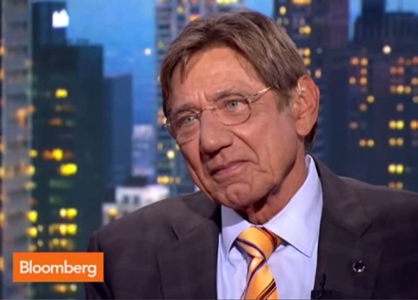
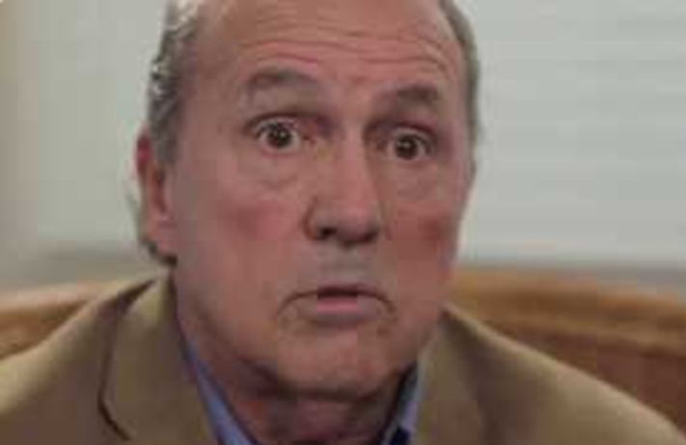
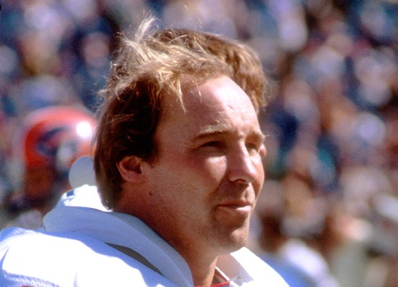
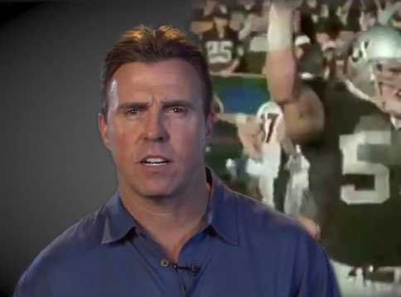
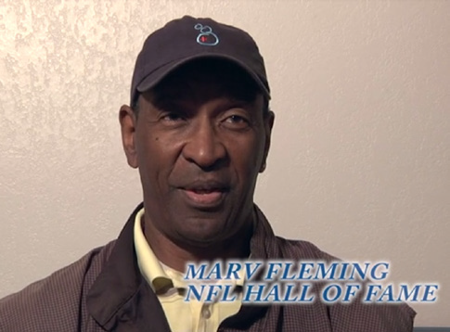
Post injury, Pre-HBOT
Post-HBOT
NFL legend Joe Namath.5 big concussions.
Memory loss, balance, brain fog. Awash in pain and suicides and CTE of friends.
Poster child for HBOT. Lectures on his recovery and deterioration of his friends. Strong advocate for HBOT and against delay and denial of Concussions in NFL.
Steve Bowman, Alabama/NY Giants. Concussion drove him to early retirement. Life and wife rapidly going downhill. Progressive dementia-like symptoms.
Went from inability to walk, think, remember, sleep to mobile husband. Wife cries gratefully: “I got my man back.”
Joe Delamielleure, Buffalo Bills, HOF 2003.
Memory, brain fog, pain. 80 dives after plea to help him in Charlotte NC.
Spokesman for HBOT. Lectures to NFL Players and veterans about his recovery and need for HBOT in every locker room.
NFL Pro Bill Romanowsky . 20 concussions over 16 years. 80 dives to fight memory loss, headaches, physical pain.
He feels HBOT should be standard of care for concussions. Continues a dive a month and proselytizes for HBOT at Super Bowl.
Marv Fleming of the Packers, Dolphins, Patriots. Memory loss, balance, headaches, physical pain.
Spokesman at SB50 for HBOT. Works to encourage other brain-damaged players to get HBOT and demand treatment.
June 2025

Slide 3
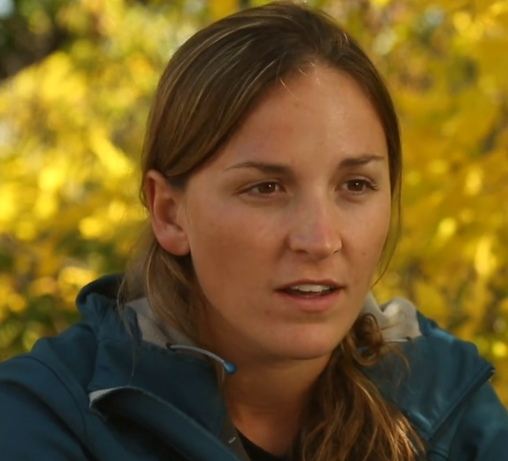
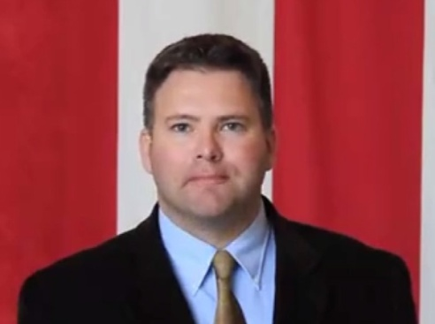
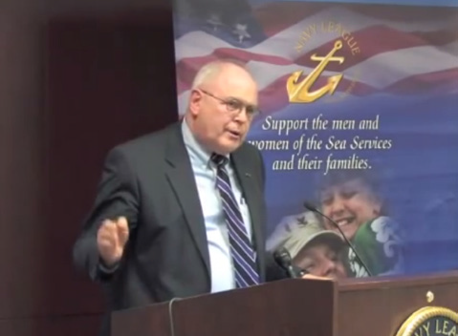
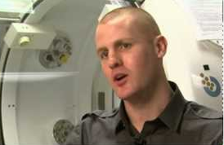
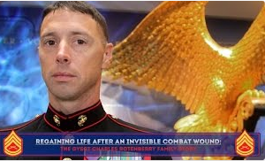
Post injury, Pre-HBOT
Post-HBOT
Margaux Mange. Iraq veteran. Major head injury, brain surgery, failed marriage, depression, suicidal. Told to get used to her new normal. Nothing more could be done.
90 dives. Hiked to South Pole with Prince Harry, hiked across US and up Denali. Essentially drug and symptom free. 4-time Wounded Warrior Olympics champion after being relegated to life on welfare. Now remarried with a daughter.
MAJ Ben Richards (USA, ret.) Iraq Veteran and 3TBI survivor. Misdiagnosed TBI for 5 years. Genius IQ reduced to full disability. DVBIC and Army had him on multiple drugs
Poster child for HBOT. Genius IQ returned after being told his “new normal” was all he could ever expect. Entrepreneur, finished his PhD, and spokesman nationwide for HBOT
Judge Patt Maney (BG, USA, ret). IED survivor Afghanistan. 15 months w/out progress at Walter Reed. 1st HBOT patient in 2006. Military and legal careers finished. Over 120 dives.
Returned to elected Judgeship. Instituted Veteran Courts in FL and lectures nationwide on need for HBOT and special treatment of veterans with brain injury. Now a FL legislator.
CAPT Matt Smotherman. OK Natl Guard. Law student before being blown up 3 times in Iraq. Could not fill out paperwork, read, sleep, focus. Drugged out of pain and into stupor.
Finished law school after 80 dives. Promoted to CAPT after being told he would have to retire on full disability. Commended personally by POTUS for efforts in OK tornado relief.
GnySgt Rotenberry (USMC, ret). IED in 2011. Pain, fatigue, depression, headaches, withdrawn. Hyperactivity. Late TBI diagnosis, 15 daily pills. Medically separated.
Wife found Dr Harch in LA. Donations paid for 40 dives. Employed at DHS as dog-handler. Life returning to “old normal.” Getting 40 more dives for lingering pain and some headaches.
June 2025

Slide 4





Post injury, Pre-Hyperbaric Oxygen Therapy (HBOT)
Post-HBOT
Senior Force Recon Marine. Survived Fallujah and over 7 concussions. Constant ER visits with migraines and 6 different pills for 13 years until wife, worried about suicide talk, found HBOT .
Refused HBOT by his unit, Cmdr approved 30-day leave. 40 dives in one month from pro bono civilian clinic. Now instructor, reports no longer “the anger gunny.”
21-year Marine SpecOps. Multiple missions. Blown up by 2 IEDs, serious parachute accident, over 1200 breaching exposures. Constant ringing in ears, eye pain and migraines. Ditto for his unit.
Wives talked. HBOT made available to this warrior and his Cmdr. 40 dives each. Both report lives drastically changed for the better. Results are consistent across other fellow Marines misdiagnosed with “only” PTSD.
Recently retired SEAL with over 2 dozen tours and dozens of concussive events: IEDs, friendly fire, breaching. Reports dozens of his unit in equally bad shape, “hollowed out” and needing help.
Treated quietly off-base, over 40 dives, after being told HBOT could ruin his career. Feels he has been given new lease on life. Advocating for forward-deployed HBOT chambers, and HBOT treatment as standard of care for combat.
AFSOC Silver Star winner in police custody for road rage. Rescued from jail by HBOT physician who provided 80 dives on pro bono basis.
Returned to active duty. Further tours and decorations. Ordered by the USAF not to talk about his treatment with HBOT.
17 year Special Operator, breecher, multiple tours, innumerable exposures. Multiple failed marriages. Suicidal. Subjected to 3 months intensive care in PREP program. Regressed to original state and psychotropic meds within 2 months.
Green Beret Foundation provided support for HBOT treatment with Dr. Zant. After 40 dives, reports off all medicines, migraines gone, wife and children ecstatic. Still on active duty and fully functional.
June 2025

